Slide 1

Data Driven Education
Discussion Forum Subteam
Presentation 1 - 2/24/2021

Slide 2






Team Members
Pratik Agrawal
Machine Learning Engineer
Aanya Khandelwal
Back-end
Developer
David Kim
Machine Learning Engineer
Sambhav Jaideep
Front-end
Web Developer
Nidhi Pai
Data Scientist
Morgan Powers
Project Manager
Notes:
All

Slide 3

Introduction
Discussion forums are used a lot in college
  Online formats
Student interaction
  Participation
  Cognitive presence
Metrics and analyses can be useful
Goal: Creating a web application to be used by professors will allow the instructors to improve their courses

Slide 4

Recap of Fall 2020
Cognitive presence modeling
Polarity and subjectivity visualizations
Super basic web application

Slide 5

Takeaways
Inter-team communication and project alignment
Trello boards
  Current progress is reflected
  Backlog provides insight for future subteams
Minutes were helpful
  Notebooks
  Review
  Future team
Design document
  Specific goals and research questions
  Future team

Slide 6

Community of Inquiry
“a group of individuals who collaboratively engage in purposeful critical discourse and reflection to construct personal meaning and confirm mutual understanding”
Elements of an Educational Experience (Garrison et al., 1999)
Notes:
Nidhi

Slide 7
Cognitive Presence (Garrison et al., 2001)
0: No Cognitive Presence
1: Triggering Event
2: Exploration
3: Integration
4: Resolution
Logistics
Socializing
“Thank you”
Unclear comments (code without comment)
Short questions
Technical clarification
“I am clueless”
“I think this is right/wrong”
Focus on the problem itself
Describing a problem
Giving suggestions
Partial understanding
Clarifications with detailed description or own assumptions
Proposing a solution
Giving their solution
Giving a textbook or other reference
Partial solutions
Confirmation of ideas
Elaboration on solution
Explain why/how solution works in detail
Definite comments
Comments from instructors
Direct answer

Slide 8
Data Available
Piazza
  258 coded posts (Spring 2021)
  No unique identifier of student
  We know what part of the post it came from
EdX
  412 (Fall 2020) + 541 (Spring 2020) coded posts
  9284 uncoded posts (Forum thread)
  9188 uncoded posts (Forum comment)
Both have timestamp, instructor endorsements
Notes:
Nidhi

Slide 9
Research Goal
To automate classification of discussion forum posts into the 5 levels of cognitive presence.

Slide 10
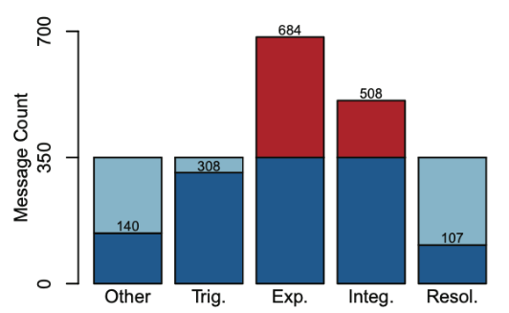
Towards Automated Content Analysis of Discussion Transcripts: A Cognitive Presence Case
Decision Tree
Data Set
Features
Model Selection
Results
Improvements
Kovanovic et al, 2016
Training/Tuning
Features
LIWC
SMOTE
Coh-Metrix
Data Set
Feature Extraction
Discussion Context Features
Resample
LSA Similarity
Kovanovic et al, 2016
Number of Named Entities

Slide 11
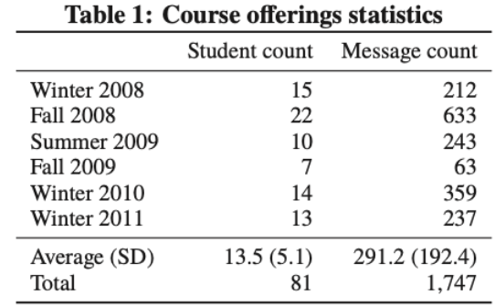
Data Set
Course:
Master's level software engineering course at a Canadian public university
Research intensive
Kovanovic et al, 2016

Slide 12
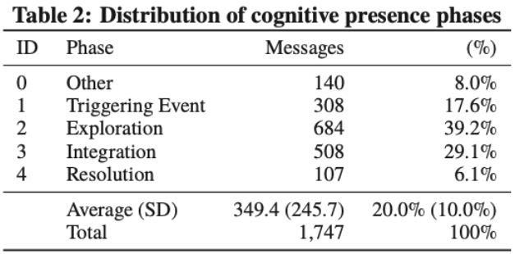
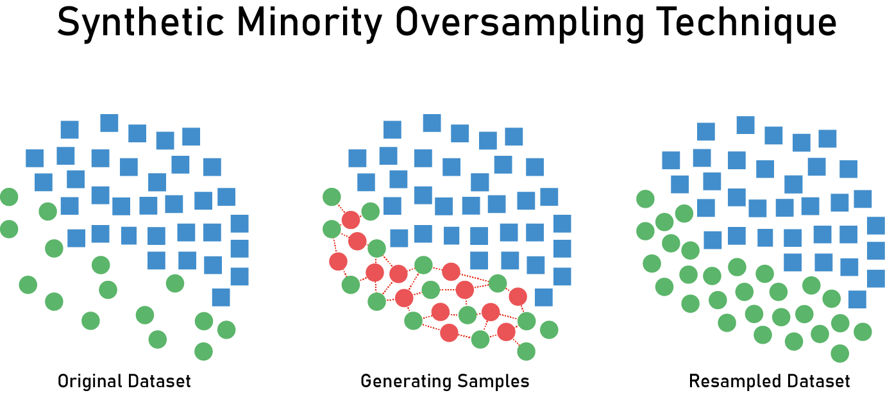
Distribution & Resampling
SMOTE
Kovanovic et al, 2016
https://medium.com/analytics-vidhya/bank-data-smote-b5cb01a5e0a2
Coded by two expert coder's with an inter-rated agreement of 98.1%

Slide 13
Linguistic Inquiry and Word Count
Four high level aggregation measures
  analytical thinking
  social status, confidence, and leadership
  authenticity
  emotional tone
Features
LIWC
Coh-Metrix
Discussion Context Features
LSA Similarity
Number of Named Entities

Slide 14
Coh-Metrix
108 metrics of text coherence
  co-reference
  referential
  causal
  spatial
  temporal
  structural cohesion
  ect...
Features
LIWC
Coh-Metrix
Discussion Context Features
LSA Similarity
Number of Named Entities

Slide 15
Discussion Context Features
Number of replies
Message depth
  The position of a message within a discussion
Cosine similarity to previous/next message
Start/end indicators
Features
LIWC
Coh-Metrix
Discussion Context Features
LSA Similarity
Number of Named Entities

Slide 16
LSA Similarity
Average sentence similarity within a message
Separate semantic space for important concepts.
  Estimate semantic similarity from Wikipedia
Features
LIWC
Coh-Metrix
Discussion Context Features
LSA Similarity
Number of Named Entities

Slide 17
Number of Named Entities
Named objects
People
Organizations
Geographic Locations
Extract the number of entities related to CS in Wikipedia through DBSpotlight.
Features
LIWC
Coh-Metrix
Discussion Context Features
LSA Similarity
Number of Named Entities

Slide 18
Model & Training
Random Forests
Measure feature importance on MDG (Mean Decrease Gini)
Hyperparameters
  Number of trees
  Number of features selected
Training
75% training
25% testing
10 repetitions of 10-fold cross validation

Slide 19
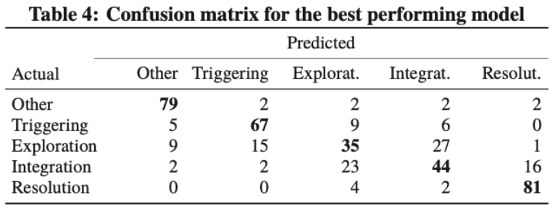
Results
Accuracy: 70.3%
Cohen Kappa = 0.63
Kovanovic et al, 2016

Slide 20
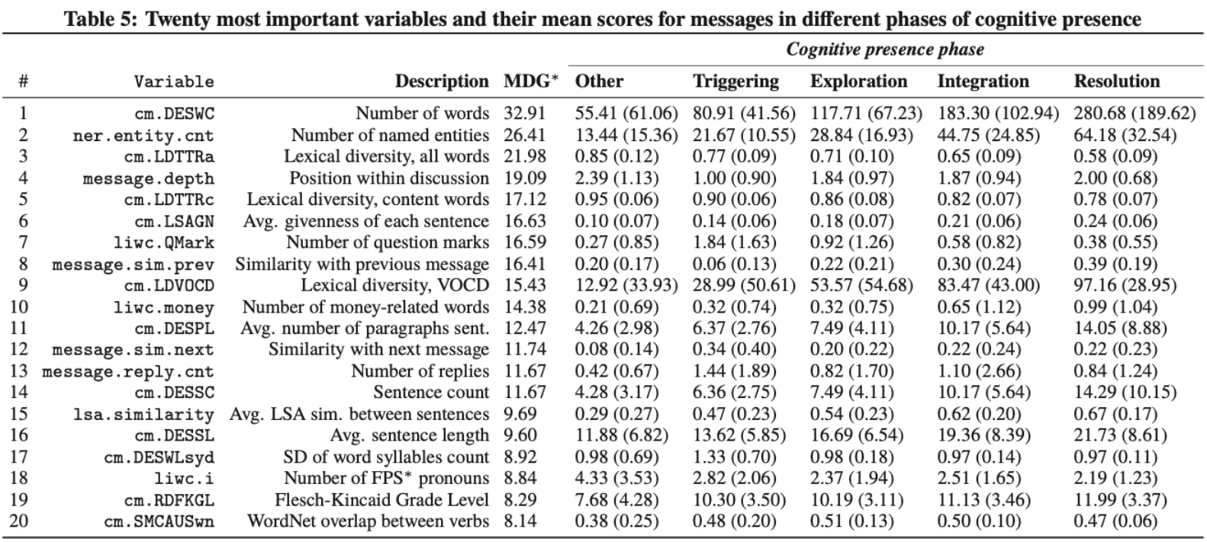
Variable Importance
Kovanovic et al, 2016

Slide 21
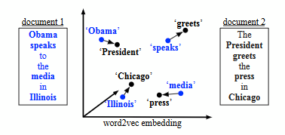
Approach used in previous semester
Word Mover’s Distance
  Words in comments mapped to embedding space using Word2vec
  K-nearest neighbors (KNN) algorithm used for classification with word mover’s distance metric
    Limitation: Sequence of words and context not captured
      Can use more relevant embeddings like sense2vec etc.
Pre-trained language models
  Fine-tuning on pre-trained BERT model
  huggingface Python API used
    Limitation: Computational cost
      Should benefit from more labelled data
The classic WMD example from [5]

Slide 22
Challenges encountered
Resource limitations: Low number of labelled samples (for ML purpose), limited computational resources
Class imbalance
High preprocessing requirements (comments with code segments, images etc.)
Dependence between subsequent comments

Slide 23
Goals for this semester (Data Science)
Replicate Kovanovic’s results
  Exploratory analysis and visualizations
  Feature Exploration
  Try probabilistic labelling (soft-labels instead of hard label assignments)
Improve the accuracy of automated classification
  Try pre-trained embeddings and transfer learning approaches
  Making modifications to previous semester’s approaches and run ablation experiments
  Improve the quality of data for use in later semesters
    Create a better pre-processing pipeline
  Reaching Cohen's kappa >= 0.7 is ideal!
Explore relationship between cognitive presence and social presence (if time permits)

Slide 24
Web Development
Back-end:
  Employ Flask to integrate the front-end web application with the back-end data
  Integrate Flask with React
  Establish a simple pipeline to process small data
  Expand the model to incorporate larger research datasets
  Incorporate efficient database management systems

Slide 25
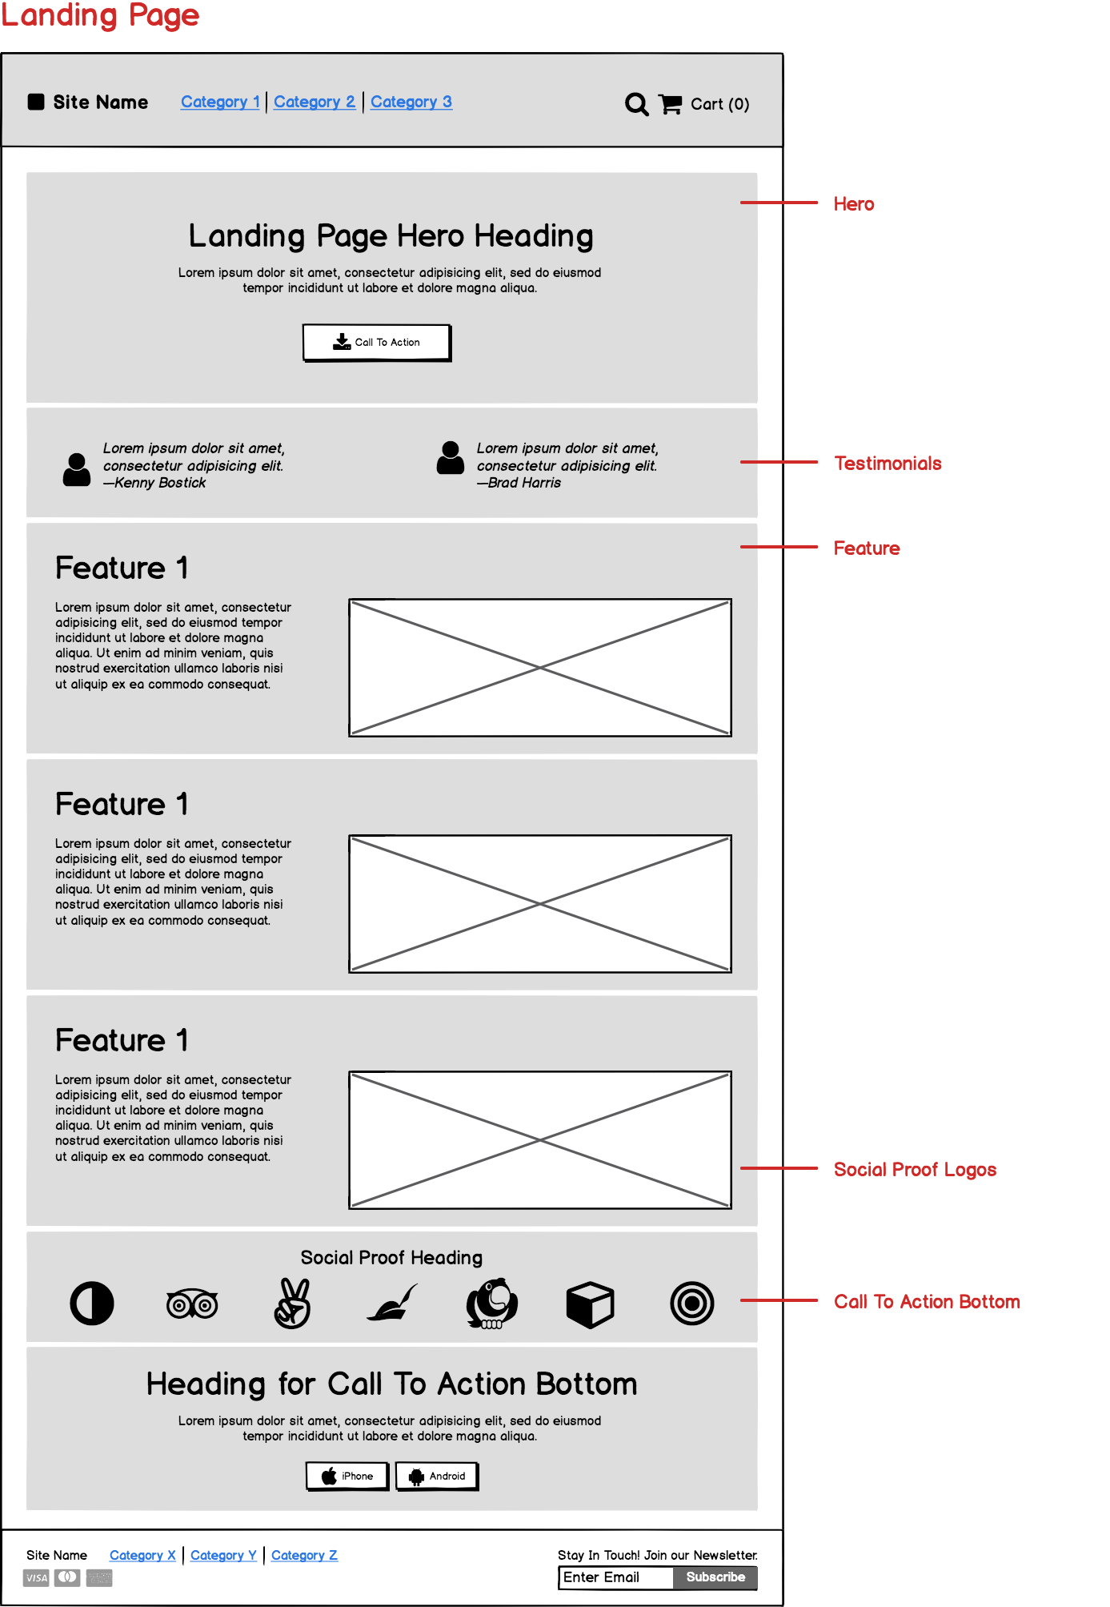

Web Development
Front-End Design:
  Figma - fast, simple way to design user interfaces
  Balsamiq - planning, low-fidelity wireframes
Preliminary React front-end (Fall 2020)

Slide 26
Web Development Goals
Web-app:
  Create a pipeline from database to front-end
  Prioritize basic, simple design/features
  Data visualizations
Logistical/Research:
  Documentation!
  Professor insights on UI/UX
    Features, graphs, etc.
  Cohesiveness & communication between sub-teams

Slide 27
Conclusion
Design document
Data science
  Piazza and edX data
  Organize discussion forums by cognitive presence
Web development
  Database → front-end
  Basic features

Slide 28
Citations
Garrison, D. R., Anderson, T., & Archer, W. (1999). Critical Inquiry in a Text-Based Environment: Computer Conferencing in Higher Education. The Internet and Higher Education, 2(2–3), 87–105. https://doi.org/10.1016/S1096-7516(00)00016-6
Garrison, D. R., Anderson, T., & Archer, W. (2001). Critical thinking, cognitive presence, and computer conferencing in distance education. American Journal of Distance Education, 15(1), 7–23. https://doi.org/10.1080/08923640109527071
Kovanovíc, V., Joksimovíc, S., Waters, Z., Gaševíc, D., Kitto, K., Hatala, M., & Siemens, G. (2016). Towards automated content analysis of discussion transcripts: A cognitive presence case. ACM International Conference Proceeding Series. https://doi.org/10.1145/2883851.2883950
https://en.wikipedia.org/wiki/Cohen%27s_kappa
Kusner, M., Sun, Y., Kolkin, N., & Weinberger, K. (2015, June). From word embeddings to document distances. In International conference on machine learning (pp. 957-966). PMLR.

Slide 29
Questions?

Slide 30
Extra Slides (may delete if not required anymore)

Slide 31
Future Work
Feature Exploration
Data Preprocessing
Probabilistic Labeling
Reaching Cohen's kappa >= 0.7 is ideal!

Slide 32
A brief look into Language Models
Feature Exploration
Data Preprocessing
Probabilistic Labeling
Reaching Cohen's kappa >= 0.7 is ideal!

